Slide 1
Under Water Image Enhancement Techniques and Image Restoration
Guided by:
Mrs M. Lalitha
Asst. Professor
Department of CSE
Submitted by:
D. Sushma -17251A0566
P. Dhatri Reddy -17251A0583
M. Sujitha -17251A05A9
P. Priyanka - 18255A0519

Slide 2
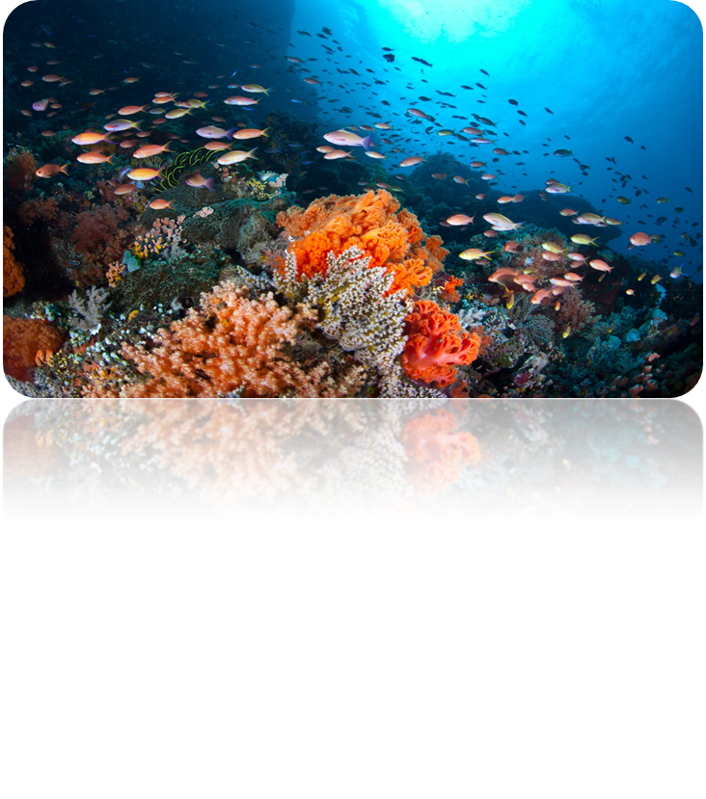
INTRODUCTION
Underwater images play a key role in ocean exploration but often suffer from severe quality degradation due to light absorption and scattering in water medium.

Slide 3
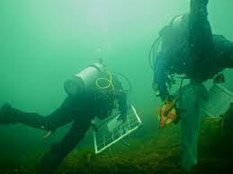
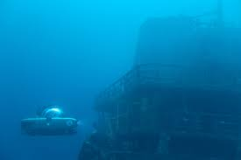
INTRODUCTION
Researchers strive to capture high-quality underwater images for a variety of underwater applications, including robotics, rescue missions, man-made structures inspection, ecological monitoring, sea organisms tracking and real-time navigation.

Slide 4
INTRODUCTION
Image enhancement techniques are used to make images lighter or darker, or to increase or decrease contrast, or to remove undesired characteristics of an image such as color cast. Low contrast is considered a serious problem as it reduces the visual quality of digital images.

Slide 5
EXISTING SYSTEM
The existing system requires the parameters of underwater imaging model estimation or use inflexible frameworks which are applicable only for specific scenarios. Like Gray-Edge Assumption (GEA) as color correction methods to modify color and saturation of the images but GEA often fails to enhance the images as the contrast of underwater images is low and the edge features are hazed.

Slide 6
PROPOSED SYSTEM
Underwater images always show color cast, e.g., green bluish color, which is caused by different attenuation ratios of red, green and blue lights and may often fail to exhibit their original hue and saturation. We aim at correcting these to produce better quality images with correct color, hue and saturation.

Slide 7
REQUIREMENTS
Flask framework of python for front End Development.
SQLyog Community edition server for Database connections.
Anaconda Prompt terminal for executing commands.
Development Tool-Visual Studio code.

Slide 8
REQUIREMENTS
Platform -Windows 10
IDE –Anaconda
Libraries – Open CV
Hardware Requirements:
Name of the Processor -Intel core i5
Hard Disk Capacity -1 TB
RAM Capacity -8.00GB

Slide 9
OBJECTIVES
The objective of the work is to enhance the quality of underwater images which generally have green-bluish hue.
Enhancing the images with using UCM(Unsupervised Color Correction Method).
Usage of CLAHE(Contrast Limited Adaptive Histogram Image Equalization) Algorithm for color correction and enhancement.

Slide 10
OBJECTIVES
Implementing underwater image enhancement algorithm based on an Integrated Color Model (ICM).
Usage of Rayleigh Distribution for image enhancement.
Comparing and analyzing the results produced by the above algorithms.

Slide 11
METHODOLOGY
Many different algorithms are available to be used currently.
We use the UCM(Unsupervised Colour Correction) based approach:
It can be done in the following 4 steps:
1) RGB equalisation
2) Stretching
3)HSV Stretching
4)Scene Radiance

Slide 12
Steps in UCM
UCM is based on three steps and each step is playing an important role to enhance the underwater images as briefly described below:
To make the image balanced.
To remove the color cast.
To improve the illumination and true color.

Slide 13
Steps in UCM
1.RGB equalisation
-Can be done with HE. Obtaining a histogram of pixel values and adjusting them to produce better quality images. Helps in improving contrast.
2. Contrast stretching
-(often called normalization) is a simple image enhancement technique that attempts to improve the contrast in an image by 'stretching' the range of intensity values it contains to span a desired range of values, the full range of pixel values that the image type concerned allows

Slide 14
Steps in UCM
3. HSV
-The Stretch Contrast HSV command does the same thing as the Stretch Contrast command, except that it works in HSV color space, rather than RGB color space, and it preserves the Hue. Thus, it independently stretches the ranges of the Hue, Saturation and Value components of the colors. Occasionally the results are good, often they are a bit odd. “Stretch Contrast HSV” operates on layers from RGB and Indexed images. If the image is Gray Scale, the menu entry is insensitive and grayed out.

Slide 15
Why UCM than any other method?
The main reason why UCM method has been able to effectively enhance the image is that it takes into account the image’s properties and enhances the image based on its characteristics rather than on static criteria in other algorithms like ICM, CLAHE.

Slide 16
Analysis
The accuracy of the image can assessed only if the original image without water is available so that the results produced can be compared.
File Size, Pixel values.
Edges detected.

Slide 17
Discussion of results
Larger images or higher resolution images, generally have larger file sizes. However, two images of the same size or resolution, are not always the same file size. The number of colors and the variation of those colors impacts file size.
-Prof. Neeraj Bhargava
A Practical Approach for Image Processing & Computer Vision In MATLAB

Slide 18
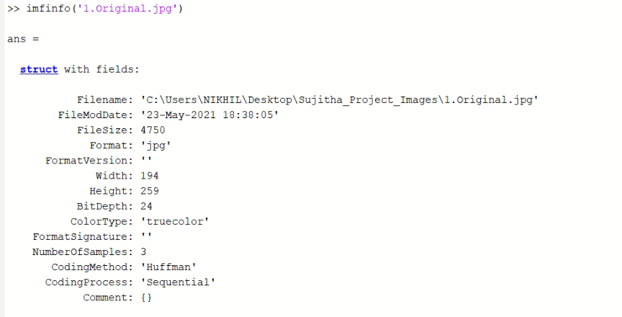
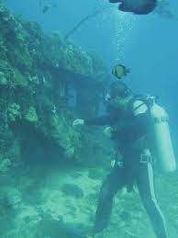
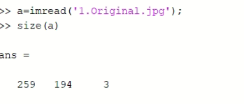
Original Image

Slide 19
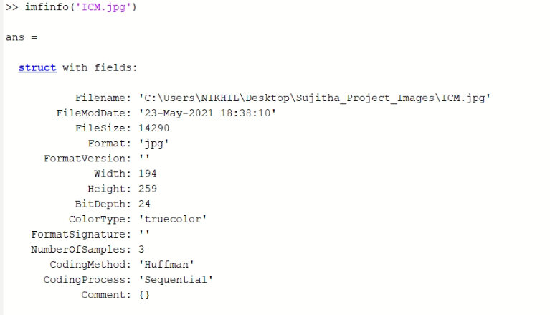
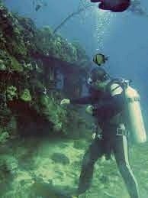
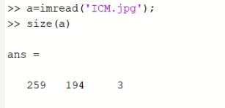
Integrated Color Model

Slide 20
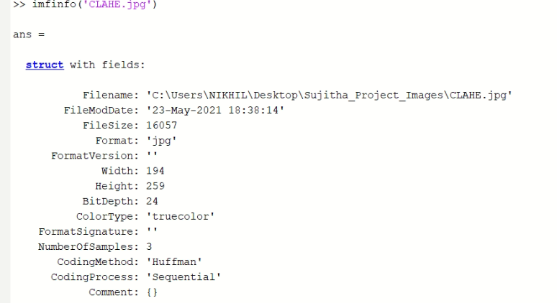
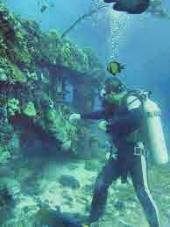
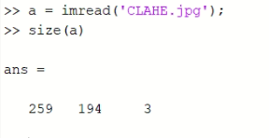
Contrast Limited Adaptive histogram equalization (CLAHE)

Slide 21
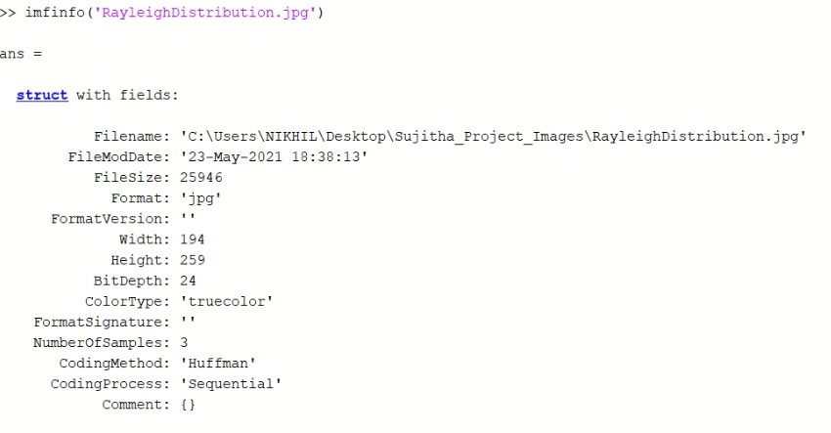
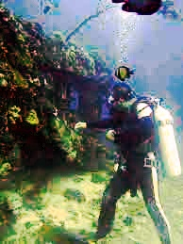
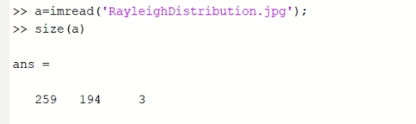
Rayleigh Distribution

Slide 22
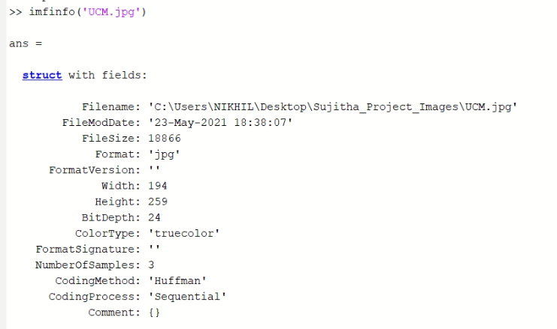
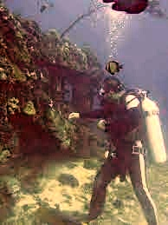
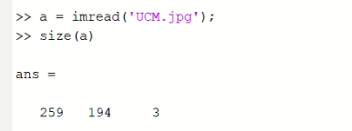
Unsupervised Color Correction Method

Slide 23
Edge Detection
Several researchers have used edge detection method in order to evaluate the performances of their methods based on number of edges found in the image.
We have used the Canny edge detection algorithm to detect the edges.

Slide 24
Edge detection using Canny Edge detection Algorithm
The images in the next slide contain original images and output images produced by Canny edge detection algorithm.
1) is the original Image.
2) is the UCM enhanced image.
3) are the edges detected form Original image.
4) are the edges detected from UCM enhanced image.

Slide 25
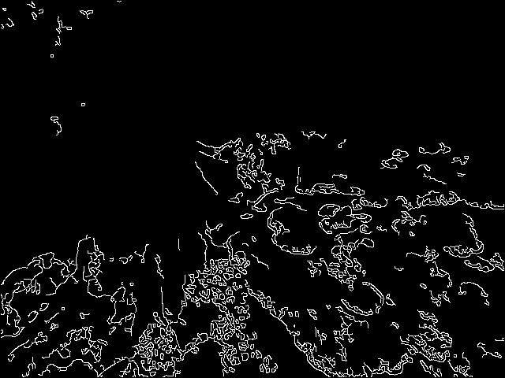
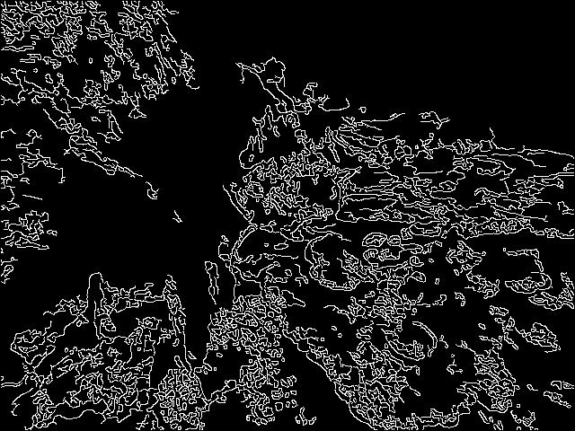
1)
2)
4)
3)

Slide 26
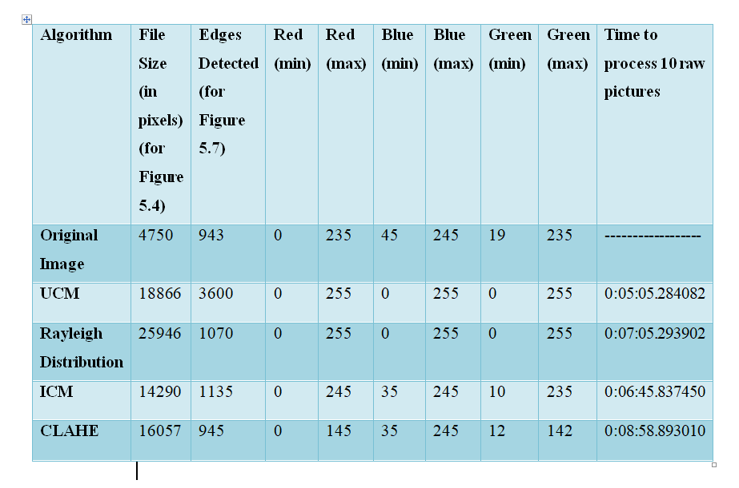
Comparison Table

Slide 27
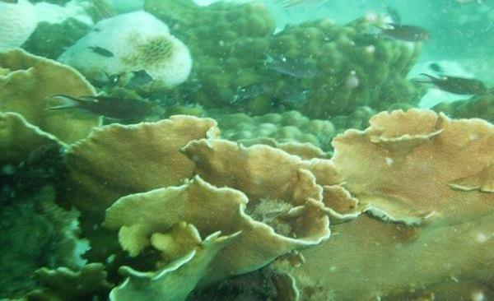
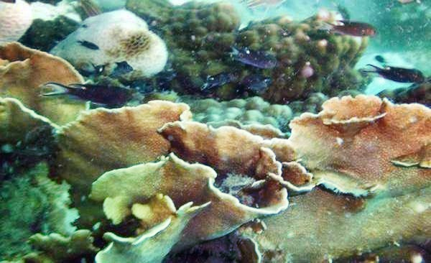
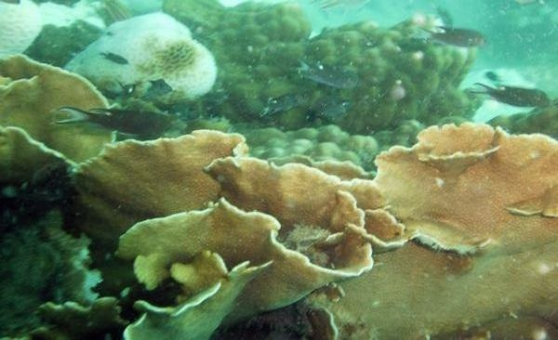
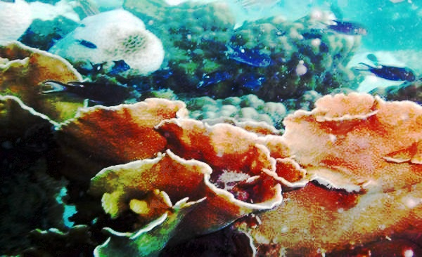
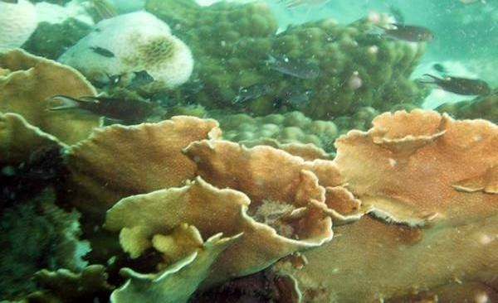
Original
CLAHE
ICM
Rayleigh Distribution
UCM

Slide 28


Output
Before enhancement
After enhancement

Slide 29
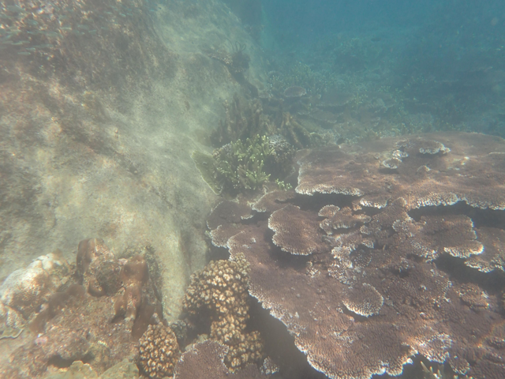
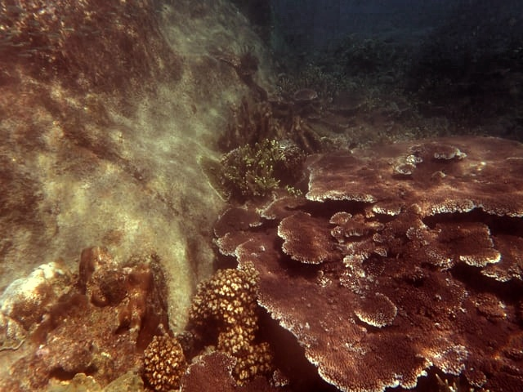
Output
Before enhancement
After enhancement

Slide 30
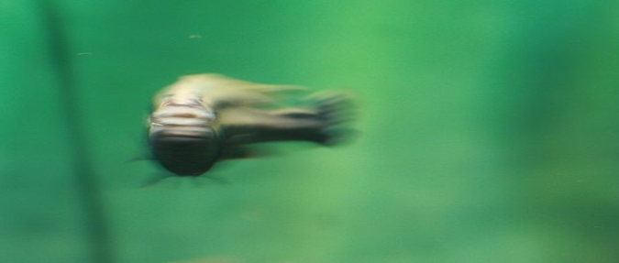
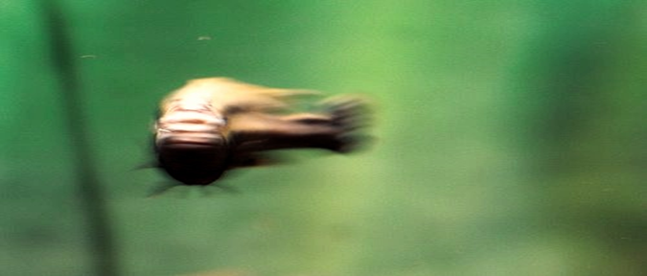
Output
Before enhancement
After enhancement

Slide 31
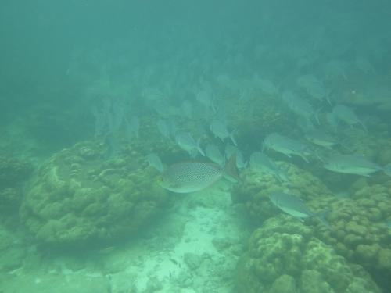
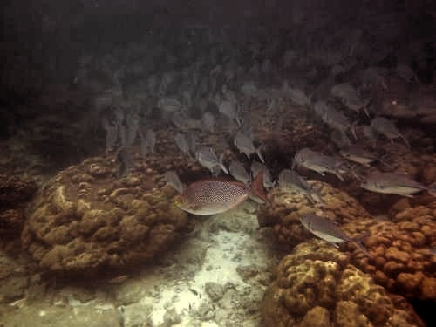
Output
Before enhancement
After enhancement

Slide 32
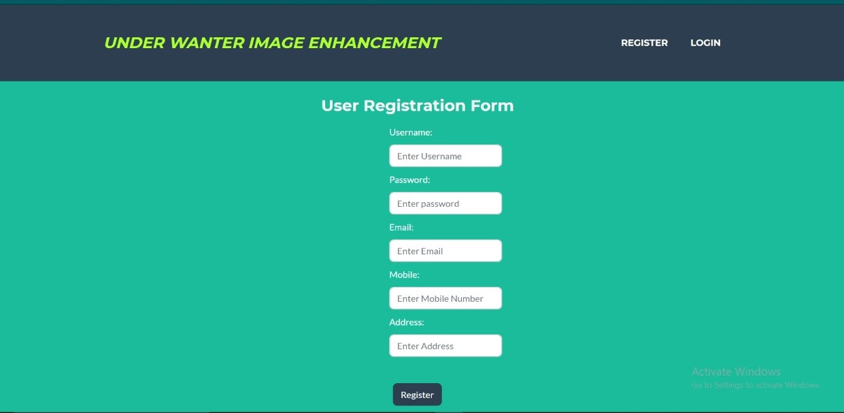
RESULTS
1.Registration Page

Slide 33
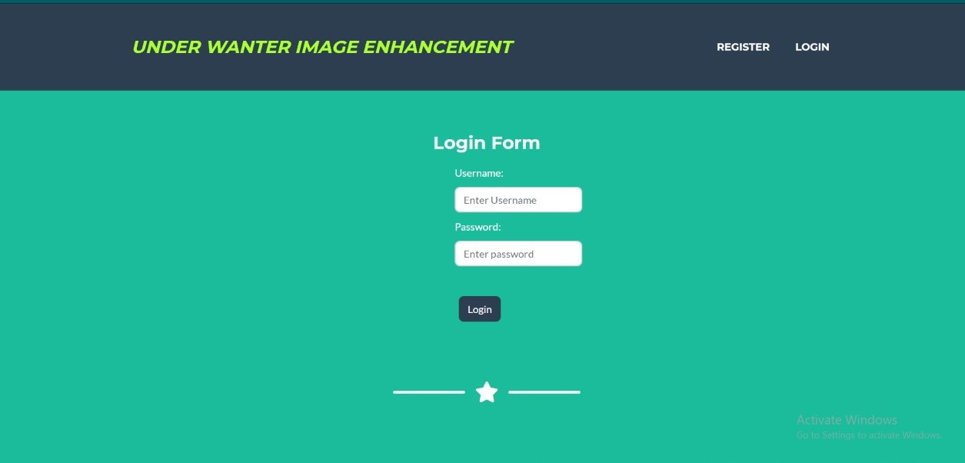
2.Login Page

Slide 34
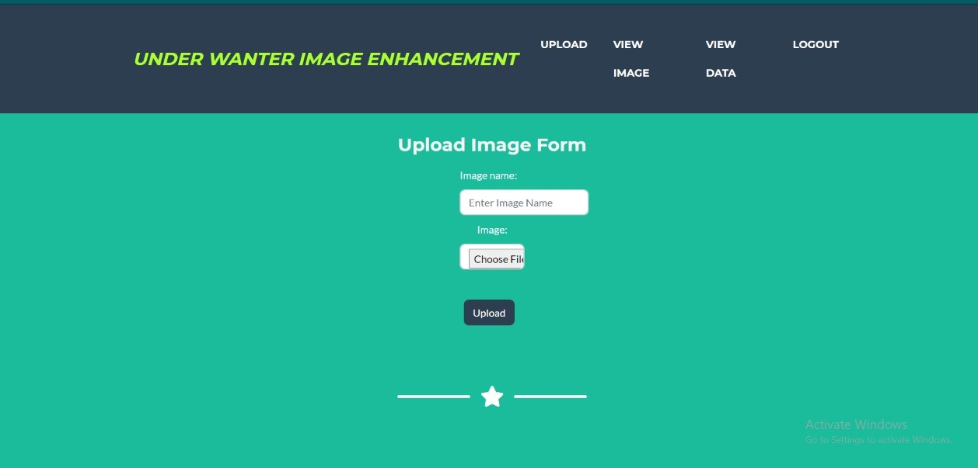
3.Upload the image with .jpg extension

Slide 35
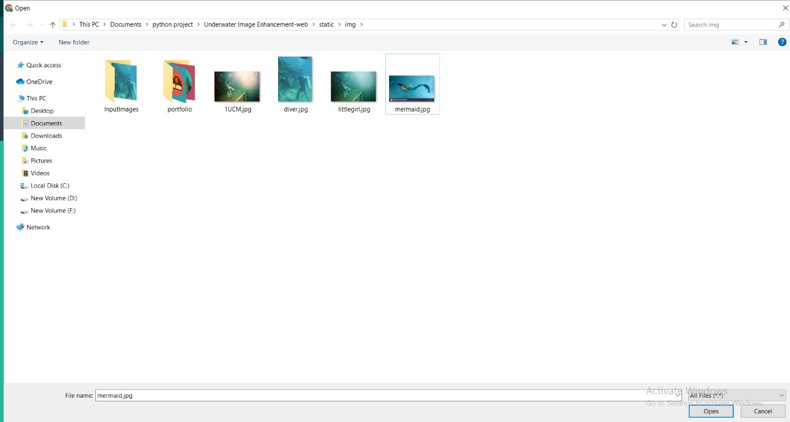
4. The Picture should be downloaded in the desired folder prior to uploading

Slide 36
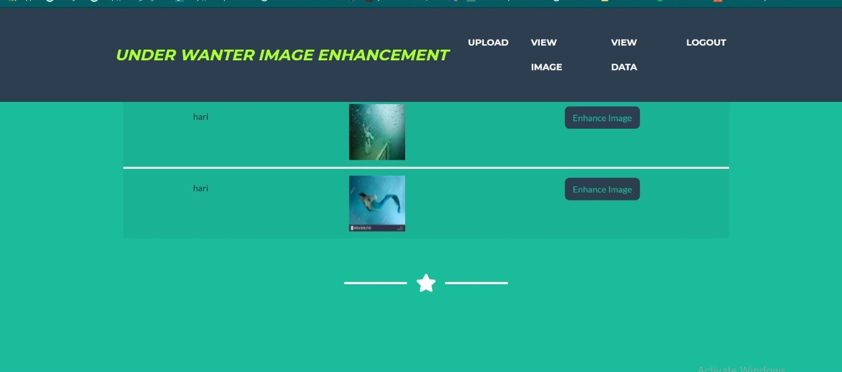
5.Uploaded image then click enhance image button to enhance the image

Slide 37
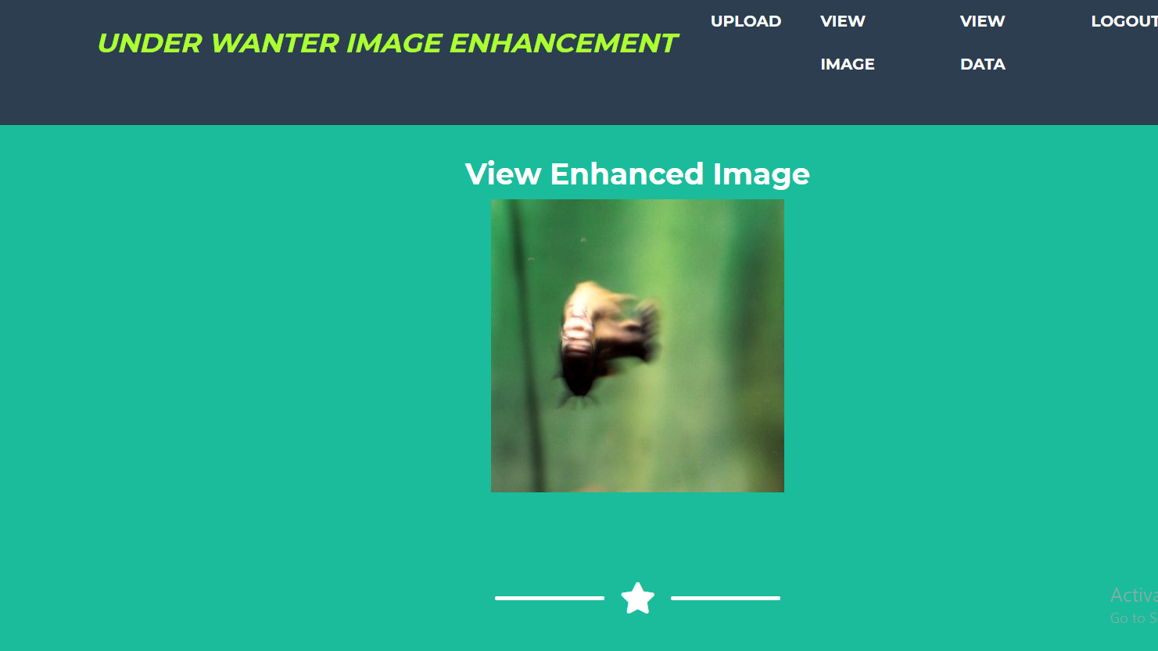
6. Output is produced on the screen

Slide 38
Thank you
.

